Slide 1
EXCEL FINAL ASSESSMENT
SWEATHA S
4398
2/4/2024

Slide 2
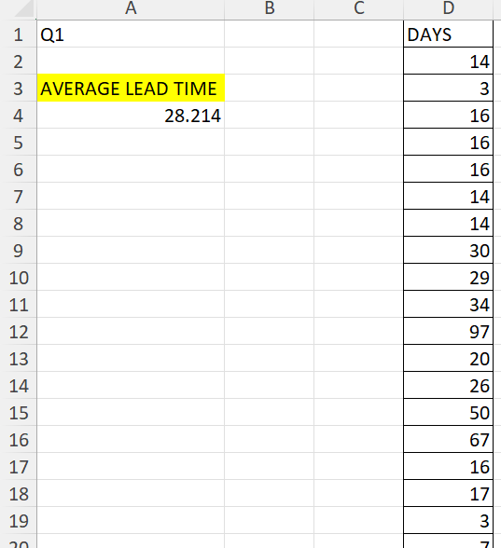
Q1
The average lead time between the request date and completion date for all work orders is 28.214.
It is calculated using the AVERAGE() function in excel after calculating the difference in days between request date and completion date using DAYS() function.

Slide 3
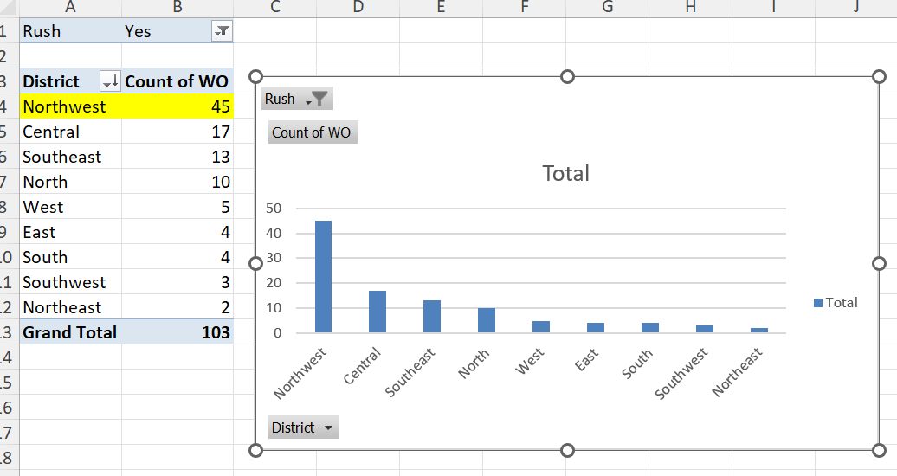
Q2
It is evident from the pivot table and bar chart that Northwest district has the highest number of rush jobs.
Rush is used as a filter here and work orders is counted in each district.

Slide 4
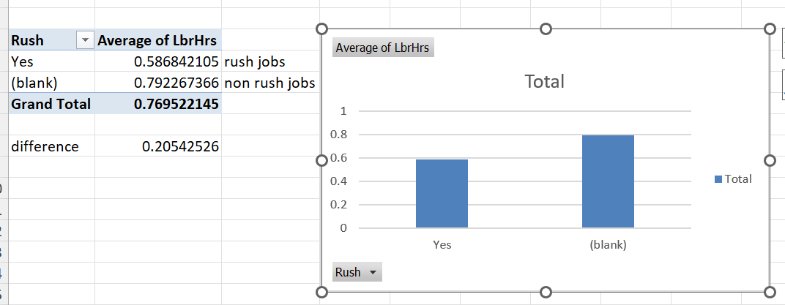
Q3
The average labour hours differs by 0.205 between rush jobs and non rush jobs (i.e) Non rush jobs have an average of 0.792 labour hours while rush jobs have 0.587.

Slide 5
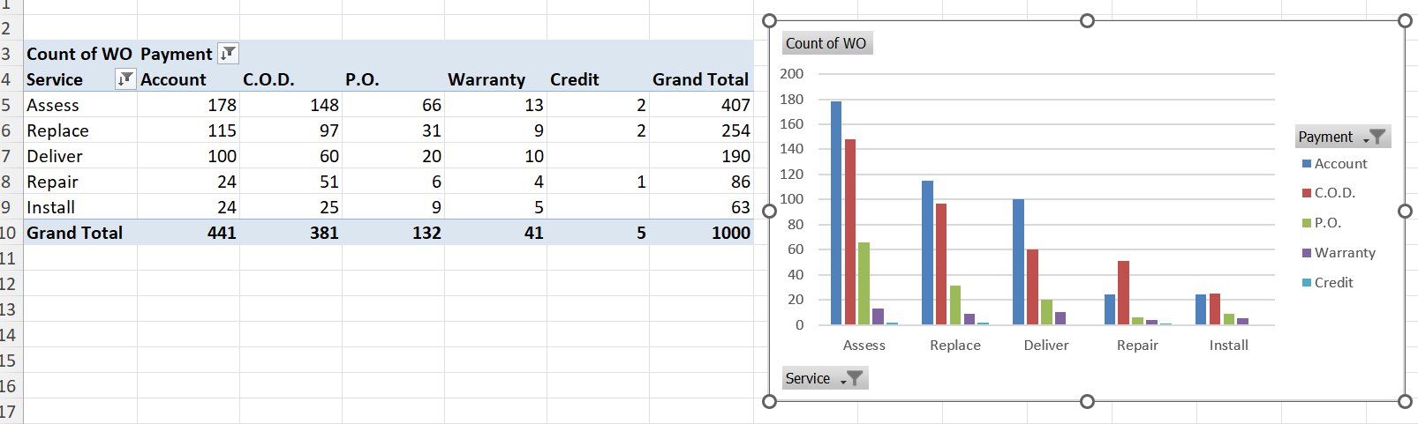
Q4
The distribution of payment types across different services is shown in the bar graph. It is evident that account mode of payment and Assess service is mostly preferred.

Slide 6
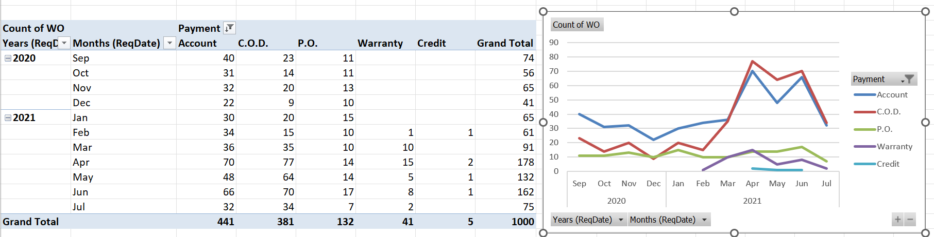
Q5
The distribution of payment types over time is shown in the line chart.
As we move from 2020 to 2021, C.O.D mode of payment is mostly preferred. In 2020, there is no much usage of warranty and credit modes.

Slide 7
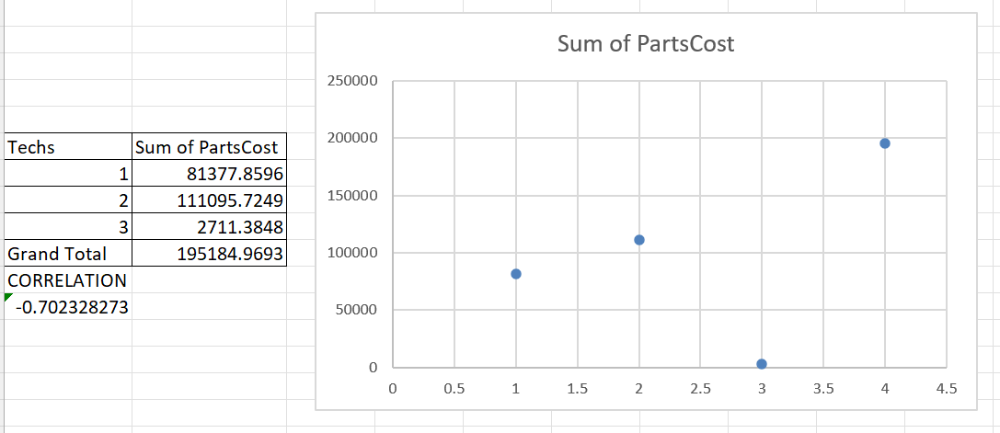
Q6
The relationship between number of technicians required and cost of parts is shown in a scatter plot. There is a negative correlation of 0.702.

Slide 8
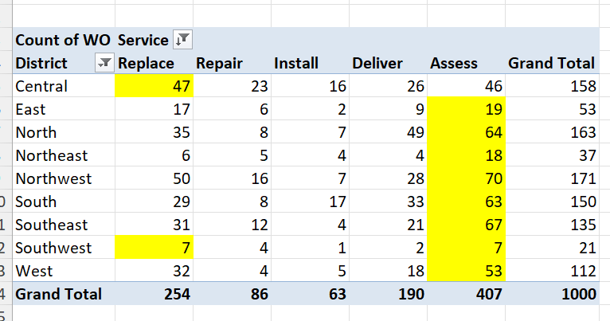
Q7
The most common type of service requested in each district is:
Central – Replace
East - assess
North - assess
Northeast-assess
Northwest-assess
South - assess
Southeast-assess
Southwest-assess and replace
West - assess

Slide 9
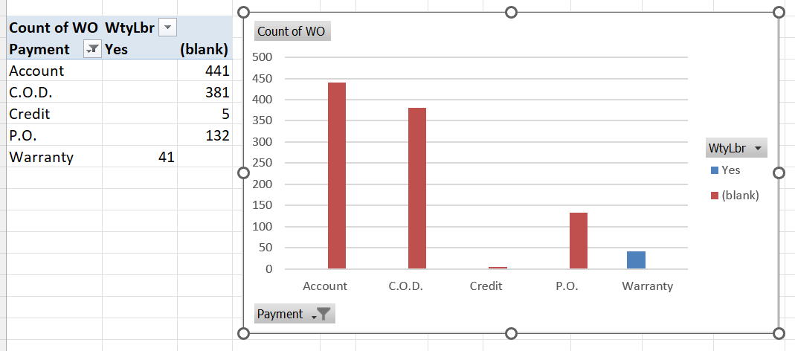
Q8
Yes, there is a difference. Those with warranty labour prefer warranty mode of payment and those without warranty labour prefer payment modes such as, Account, C.O.D, Credit,P.O etc.

Slide 10
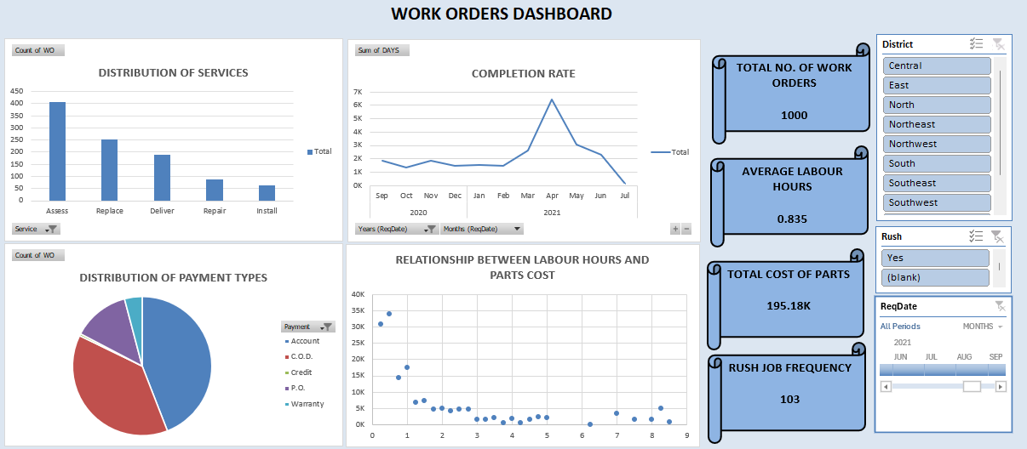
Q9 - DASHBOARD

Slide 11
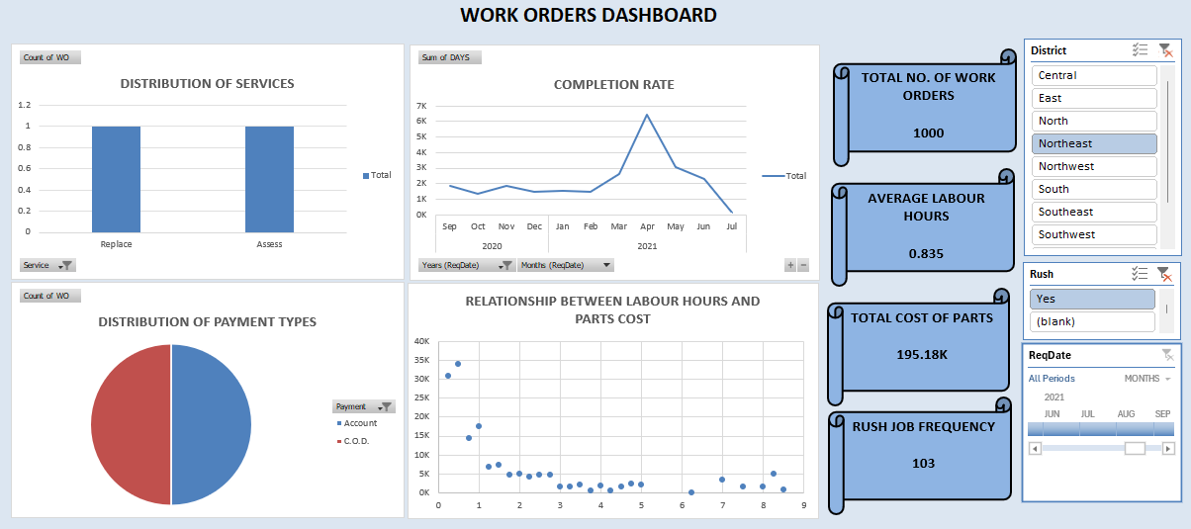
Q9 – DASHBOARD for specific region and rush job

Slide 12
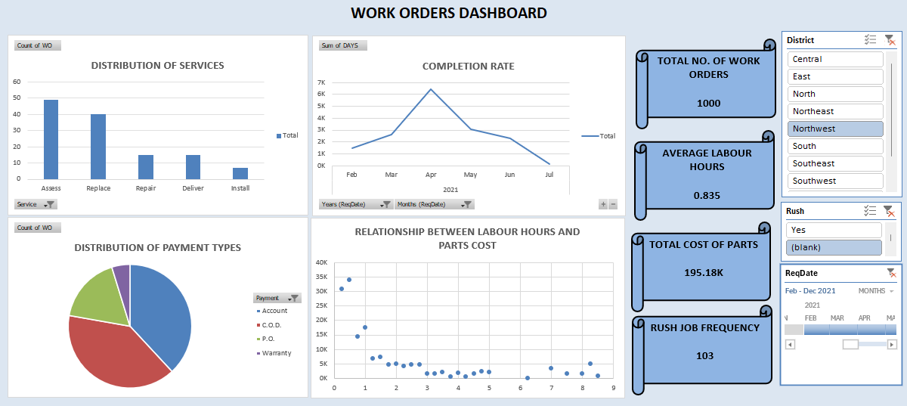
Q9 – DASHBOARD for specific timeline and a specified region and non rush jobs

